Slide 1
AI诗人：循环神经网络
项目六
物联网工程学院

Slide 2
项目目标
知识目标
循环神经网络的发展历史
循环神经网络的特点与应用
循环神经网络的结构
遗忘门、记忆门、输出门的结构与作用
能力目标
使用Keras API搭建RNN
使用Keras API搭建LSTM
能构建文本数据集
熟练训练、评估模型

Slide 3
认识循环神经网络
任务1

Slide 4
Hopfield Network
循环神经网络源自于1982年由Saratha Sathasivam提出的霍普菲尔德网络（Hopfield Network）。
1990年，Jeffrey L. Elman对Jordan Network进行了简化，并采用BP算法进行训练，便有了单个自连接节点的RNN模型。

Slide 5
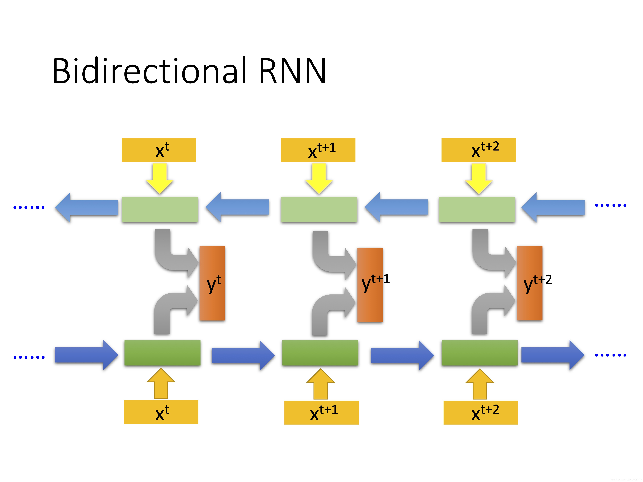
LSTM
LSTM Networks 是递归神经网络（RNNs）的一种，该算法由 Sepp Hochreiter 首次公布。后经过人们的不断改进，LSTM 的内部结构逐渐变得完善起来。在处理和预测时间序列相关的数据时会比一般的 RNNs 表现的更好。

Slide 6
Transformer
2014年Bengio团队提出了seq2seq架构与注意力Attention机制。
2017年Google提出Transformer架构，使用Self-Attention代替原有的RNN及CNN，更进一步降低了模型复杂度

Slide 7
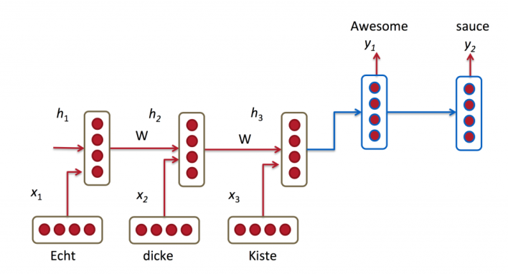
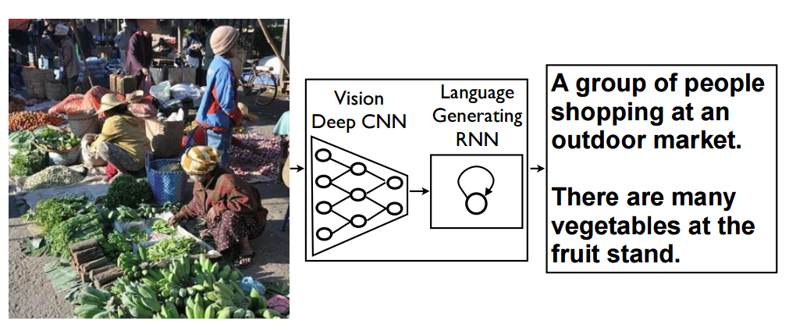
RNN应用
基于序列到序列的机器翻译
图像描述生成

Slide 8
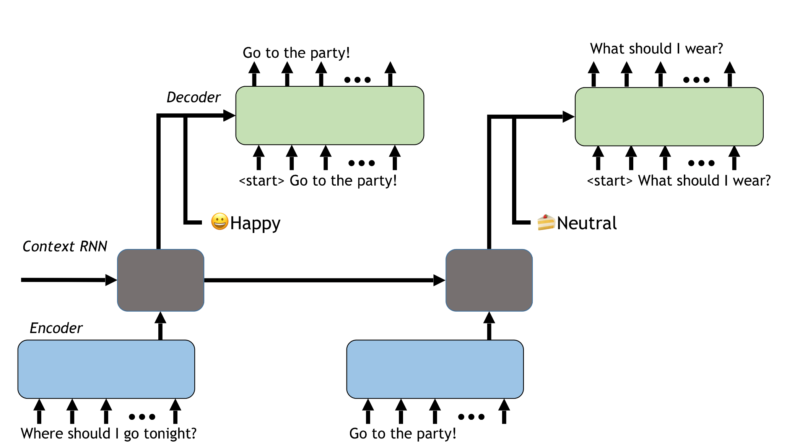
RNN应用

Slide 9
为什么需要 RNN
算法
输入
输出
今天天气特别好，我想去___。
?

Slide 10
电影评论分类
任务2

Slide 11
序列模型
一对一
一对多
多对一
多对多

Slide 12
全连接网络
正面评价
Dense
Dense
输入
我
爱
我
的
祖
国

Slide 13
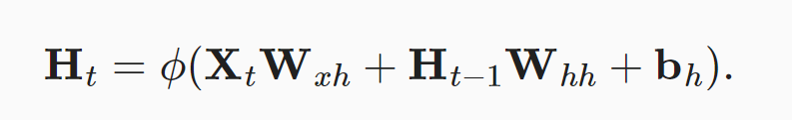
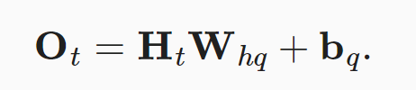
RNN模型结构
Ot
输出
1
h_{t}
隐藏层
A
2
Xt
输入

Slide 14
RNN模型结构
1
O₀
O1
O2
O3
O4
O5
h₀
h₁
h₂
h₃
h₄
h₅
A
A
A
A
A
A
我
爱
我
的
祖
国

Slide 15
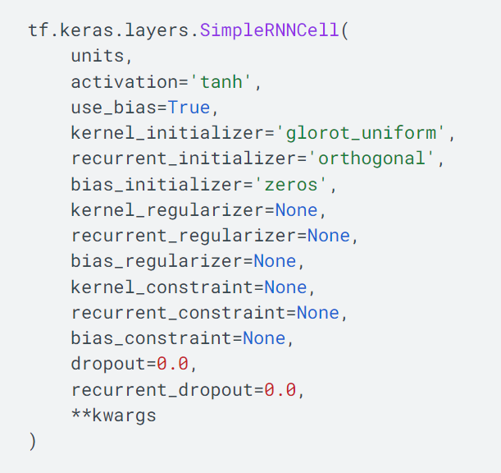
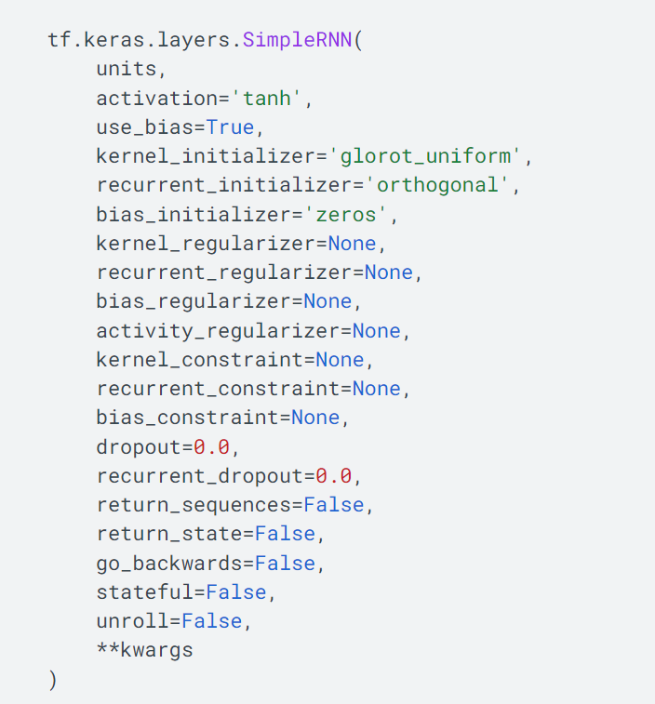
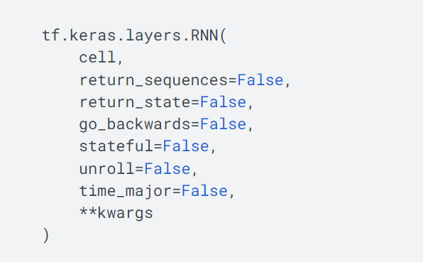
SimpleRNNCell

Slide 16
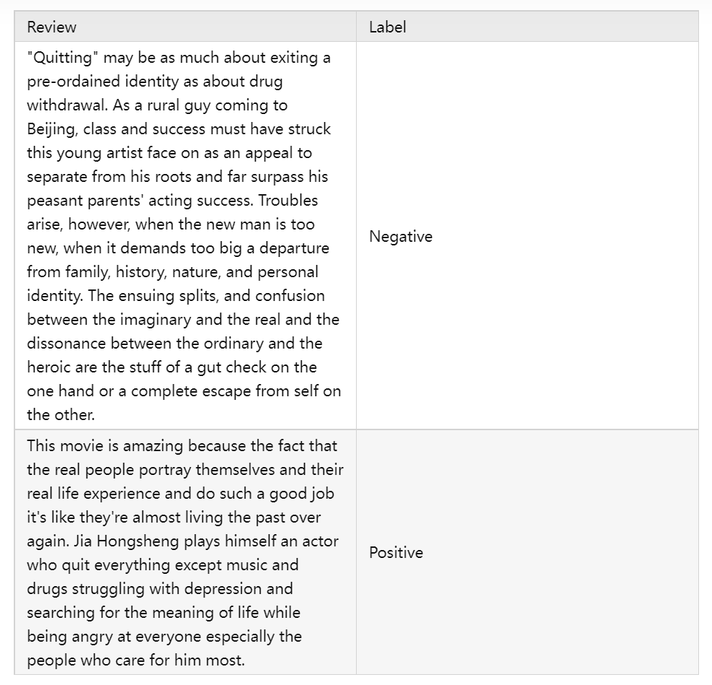

IMDB数据集

Slide 17
# 下载数据集
In[1]:
import numpy as np
import tensorflow as tf
from tensorflow import keras
imdb = keras.datasets.imdb
(train_data, train_labels), (test_data, test_labels) = imdb.load_data(num_words=10000)
print("Training entries: {}, labels: {}".format(len(train_data), len(train_labels)))
print(train_data[0])
Training entries: 25000, labels: 25000
[1, 14, 22, 16, 43, 530, 973, 1622, 1385, 65, 458, 4468, 66 …]
Out[1]:

Slide 18
# 将评论解码为英文单词
In[2]:
word_index = imdb.get_word_index()
word_index = {k:(v+3) for k,v in word_index.items()}
word_index["<PAD>"] = 0
word_index["<START>"] = 1
word_index["<UNK>"] = 2 # unknown
word_index["<UNUSED>"] = 3
reverse_word_index = dict([(value, key) for (key, value) in word_index.items()])
def decode_review(text):
return ' '.join([reverse_word_index.get(i, '?') for i in text])
decode_review(train_data[0])
'<START> this film was just brilliant casting location scenery story direction everyone's really suited the part they played and you could just imagine being there Robert …
Out[2]:

Slide 19
# 预处理
In[3]:
print('Maximum review length: {}'.format(
len(max((train_data + test_data), key=len))))
print('Minimum review length: {}'.format(
len(min((train_data + test_data), key=len))))
max_words = 500
x_train = keras.preprocessing.sequence.pad_sequences(train_data, maxlen=max_words)
x_test = keras.preprocessing.sequence.pad_sequences(test_data, maxlen=max_words)
Maximum review length: 2697
Minimum review length: 70
Out[3]:

Slide 20
# 构建模型
In[4]:
vocabulary_size = 10000
model = tf.keras.Sequential([
tf.keras.layers.Embedding(vocabulary_size, 100),
tf.keras.layers.SimpleRNN(64,return_sequences=True),
tf.keras.layers.SimpleRNN(64),
tf.keras.layers.Dense(1)
])
print(model.summary())
…
Total params: 1,018,881
Trainable params: 1,018,881
Non-trainable params: 0
Out[4]:

Slide 21
# 编译与训练
In[5]:
model.compile(loss=tf.keras.losses.BinaryCrossentropy(from_logits=True),
optimizer=tf.keras.optimizers.Adam(1e-4),
metrics=['accuracy'])
history = model.fit(x_train, train_labels, validation_split = 0.2, batch_size=64, epochs=20)
…
Epoch 19/20
313/313 [==============================] - 138s 440ms/step - loss: 0.0013 - accuracy: 0.9999 - val_loss: 0.7395 - val_accuracy: 0.8626
Epoch 20/20
313/313 [==============================] - 134s 429ms/step - loss: 8.2593e-04 - accuracy: 0.9999 - val_loss: 0.7883 - val_accuracy: 0.8614
Out[5]:

Slide 22
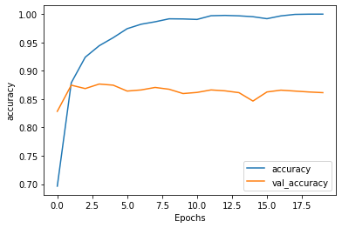
# 预测
In[6]:
test_loss, test_acc = model.evaluate(x_test, test_labels, verbose=0)
print('Test Loss: {}'.format(test_loss))
print('Test Accuracy: {}'.format(test_acc))
def plot_graphs(history, metric):
plt.plot(history.history[metric])
plt.plot(history.history['val_'+metric], '')
plt.xlabel("Epochs")
plt.ylabel(metric)
plt.legend([metric, 'val_'+metric])
plt.show()
plot_graphs(history,'accuracy')
plot_graphs(history,'loss')

Slide 23
AI诗人- LSTM
任务3

Slide 24
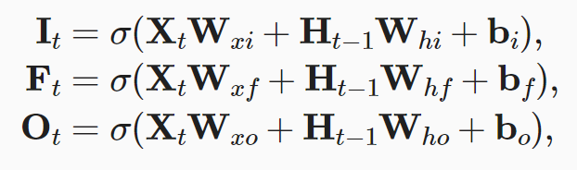
输入门、忘记门和输出门
1
候选记忆细胞
遗忘门
输入门
输出门
F_{t}
I_{t}
C_{t}
O_{t}
σ
σ
tanh
σ
H_{t-1}
0
1
2
3
X_{t}

Slide 25
候选记忆细胞
1
候选记忆细胞
遗忘门
输入门
输出门
F_{t}
I_{t}
C_{t}
O_{t}
σ
σ
tanh
σ
H_{t-1}
0
1
2
3
X_{t}

Slide 26
记忆细胞
1
记忆细胞
C_{t-1}
✖
+
✖
遗忘门 F_{t}
输入门 I_{t}
候选记忆细胞 C_{t}
输出门 O_{t}
σ
σ
tanh
σ
隐藏状态
H_{t-1}
0
1
2
3
输入
X_{t}

Slide 27
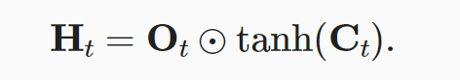
隐藏状态
1
记忆细胞
C_{t-1}
✖
+
C_{t}
tanh
✖
✖
遗忘门 F_{t}
输入门 I_{t}
候选记忆细胞 C_{t}
输出门 O_{t}
σ
σ
tanh
σ
隐藏状态
H_{t-1}
0
1
2
3
H_{t}
输入
X_{t}

Slide 28
# 下载数据集
In[1]:
import tensorflow as tf
import matplotlib.pyplot as plt
import numpy as np
import platform
import time
import pathlib
import os
cache_dir = './tmp'
dataset_file_name = 'shakespeare.txt'
dataset_file_origin = 'https://storage.googleapis.com/download.tensorflow.org/data/shakespeare.txt'
dataset_file_path = tf.keras.utils.get_file(
fname=dataset_file_name,
origin=dataset_file_origin,
cache_dir=pathlib.Path(cache_dir).absolute()
)
Maximum review length: 2697
Minimum review length: 70

Slide 29
# 分析数据
In[2]:
# Reading the database file.
text = open(dataset_file_path, mode='r').read()
vocab = sorted(set(text))
print ('{} unique characters'.format(len(vocab)))
print('Length of text: {} characters'.format(len(text)))
print(text[:250])
65 unique characters
Length of text: 1115394 characters
First Citizen: Before we proceed any further, hear me speak.
All: Speak, speak.
First Citizen: You are all resolved rather to die than to famish?
Out[2]:

Slide 30
# 处理文本
In[3]:
char2index = {char: index for index, char in enumerate(vocab)}
index2char = np.array(vocab)
text_as_int = np.array([char2index[char] for char in text])
print('text_as_int length: {}'.format(len(text_as_int)))
print('{} --> {}'.format(repr(text[:15]), repr(text_as_int[:15])))
text_as_int length: 1115394
'First Citizen:\n' --> array([18, 47, 56, 57, 58, 1, 15, 47, 58, 47, 64, 43, 52, 10, 0])
Out[3]:

Slide 31
# 创建训练数据集
In[4]:
sequence_length = 100
examples_per_epoch = len(text) // (sequence_length + 1)
char_dataset = tf.data.Dataset.from_tensor_slices(text_as_int)
sequences = char_dataset.batch(sequence_length + 1, drop_remainder=True)
def split_input_target(chunk):
input_text = chunk[:-1]
target_text = chunk[1:]
return input_text, target_text
dataset = sequences.map(split_input_target)

Slide 32
# 创建训练批次
In[5]:
# Batch size.
BATCH_SIZE = 64
BUFFER_SIZE = 10000
dataset = dataset.shuffle(BUFFER_SIZE).batch(BATCH_SIZE, drop_remainder=True)
dataset
<BatchDataset shapes: ((64, 100), (64, 100)), types: (tf.int64, tf.int64)>
Out[5]:

Slide 33
# 搭建模型
In[6]:
vocab_size = len(vocab)
embedding_dim = 256
rnn_units = 1024
def build_model(vocab_size, embedding_dim, rnn_units, batch_size):
model = tf.keras.Sequential([
tf.keras.layers.Embedding(vocab_size, embedding_dim,
batch_input_shape=[batch_size, None]),
tf.keras.layers.LSTM(128, dropout=0.5, return_sequences=True),
tf.keras.layers.LSTM(128, dropout=0.5, return_sequences=True),
tf.keras.layers.Dense(vocab_size)
])
return model
model = build_model(vocab_size = len(vocab), embedding_dim=embedding_dim,
rnn_units=rnn_units,batch_size=BATCH_SIZE)
model.summary()

Slide 34
# 编译与训练
In[7]:
checkpoint_dir = 'tmp/checkpoints'
os.makedirs(checkpoint_dir, exist_ok=True)
checkpoint_prefix = os.path.join(checkpoint_dir, 'ckpt_{epoch}')
checkpoint_callback=tf.keras.callbacks.ModelCheckpoint(
filepath=checkpoint_prefix,
save_weights_only=True
)
EPOCHS= 20
model.compile(optimizer=tf.keras.optimizers.Adam(learning_rate=0.001),
loss=tf.keras.losses.sparse_categorical_crossentropy(from_logits=True
))
history = model.fit(
x=dataset, epochs=EPOCHS, callbacks=[checkpoint_callback]
)

Slide 35
# 生成文本
In[8]:
def generate_text(model, start_string):
num_generate = 1000
input_eval = [char2idx[s] for s in start_string]
input_eval = tf.expand_dims(input_eval, 0)
text_generated = []
temperature = 1.0
model.reset_states()
for i in range(num_generate):
predictions = model(input_eval)
predictions = tf.squeeze(predictions, 0)
predictions = predictions / temperature
predicted_id = tf.random.categorical(predictions, num_samples=1)[-1,0].numpy()
input_eval = tf.expand_dims([predicted_id], 0)
text_generated.append(idx2char[predicted_id])
return (start_string + ''.join(text_generated))

Slide 36
# 生成文本
In[8]:
print(generate_text(model, start_string=u"ROMEO: "))
ROMEO: God do not burden me.
GREMIO:
I want the king that murders writ upon your tongue
And born too supplict, but thanks
We should to him and nothing can I never my
brothers forbeard our words:
Confess which have wine, and provide thee
And see how did bestride our nobising duke,
Whose souls more pleased, that men are worst challenge into a farmet together
Let hate not so, for these own with him.
Tailors:
But now the blood of two,
You and your accused find your wars.
……

